Slide 1
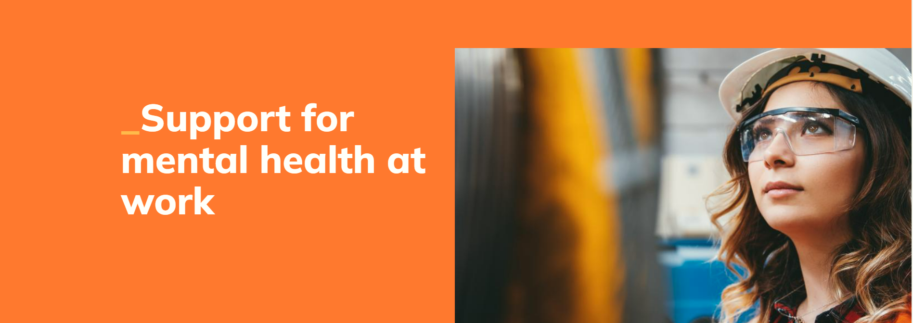
Able Futures can help you manage your mental health at work so you can enjoy more good days.
Nine months confidential, no cost advice, guidance and support from mental health professionals to help you cope with work while you learn coping mechanisms, build resilience, access therapy, manage a mental health condition such as anxiety, depression or stress or work with your employer to make adjustments to help your mental health at work.
Call Able Futures free on 0800 321 3137 from 8am to 10.30pm.
Monday to Friday to find out more about our online mental health support.

Slide 2
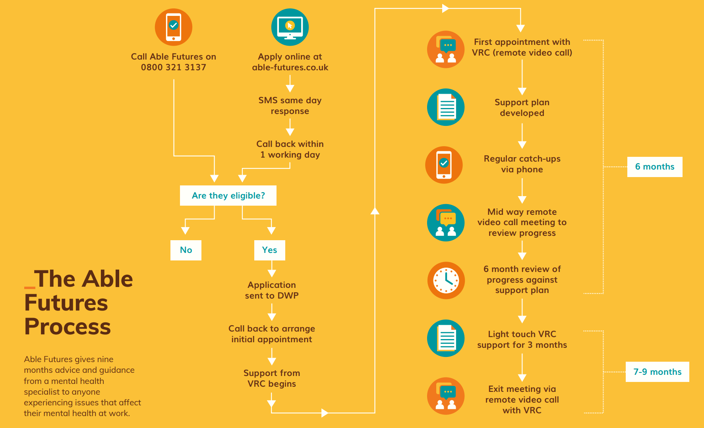
Amends needed. Email sent

