Slide 1
Bolton’s Virtual School PEP Delegated Portal Roll Out - Designated Training

Slide 2
e-Pep Roll Out
Every child has the right to express their views, feelings and wishes in all matters affecting them, and to have their views considered and taken seriously. (UNCTC; Article 12)
(respect for the views of the child)
Bolton’s Virtual School
PEPs
Benefits of using the Delegation Portal and equipment required
The process
Demo/Walk Through
Questions
How to complete the termly PEP document

Slide 3
Bolton’s Virtual School
We now have a new Virtual School team, to meet the needs of the looked after children in Bolton, focusing on inclusion and supporting them to get the most from their education experiences.
All new members of the team are qualified teachers and have experience within schools and Local Authorities.
You should have the names and contact details of the team but we also have a generic inbox which is managed by the Head and Deputy Head: virtual.school@bolton.gov.uk
Please get in touch with your Virtual School Lead or via the address above should you have any queries at all.

Slide 4
Bolton’s Virtual School – update on the team and their priorities
Lindsay Nelson Virtual School Head (full-time)
Catherine Hobday
Virtual School Deputy Head
Jane Westhead
Previously Looked after Lead (2 days)
Alexis Holt-Garner
SEND Lead
Kim Young
Primary PEP Lead (full-time)
Gill Bentham
Secondary PEP Lead (full-time)
Debbie Selby Post-16 Advisor (full-time)
Vicky Lever Early-Years Advisor (2 days)
Billy Vanden
Transitions Lead (2 days)
Key Stage 4 mentor (3 days)
Well-being mentor (3 days)
Education Opportunities Lead (3 days)
Dr Julie Alfrey
Education Psychologist (3 days)
All new members of staff, including the Head and Deputy Head have QTS and experience of working in schools, some in Local authorities to ensure effective challenge and support to schools and expertise in supporting our children.

Slide 5
Personal Education Plan (PEPs)
All looked after children must have a care plan, of which the PEP is an integral part.
The PEP should be a ‘living document’ which MUST be reviewed at least once a term.
Every education meeting within school should involve the PEP document.
Outcome focussed in line with Aspirations of the Child
Pupil Premium Grant spend
Story of the child’s current educational progress
Evidences how school is meeting the child’s educational needs.
Feeds into the statutory review of the wider care plan.
The quality of the PEP is the joint responsibility of the local authority that looks after the child and the school. All of those involved in the PEP process at all stages should involve the child and, where appropriate, the child’s parent and/or relevant family members.
Notes:
All looked after children must have a care plan, of which the PEP is an integral part. Statutory guidance describes the PEP as a ‘living document’ which MUST be reviewed at least once a term. Every education meeting within school should involve the PEP document.
This should include mapping how the pupil premium and any other additional funding has been used to support the targets set in the PEP; the PEP should be very much outcome focus in line with the Child’s aspirations. This is to ensure that the story of the child’s educational progress is current and continues to meet the child’s educational needs. It is also to ensure that information from the PEP is available to feed into the next statutory review of the wider care plan.
The quality of the PEP is the joint responsibility of the local authority that looks after the child and the school. Social workers, carers, VSHs, designated teachers and, as appropriate, other relevant professionals will need to work closely together. All of those involved in the PEP process at all stages should involve the child and, where appropriate, the child’s parent and/or relevant family members.

Slide 6
Personal Education Plan (PEPs)
To be effective and high quality, a PEP should:
be a ‘living’, evolving, comprehensive and enduring record of the child’s experience, progress and achievement (academic and otherwise), and inform any discussion about education during statutory reviews of the child’s wider care plan;
be linked to, but not duplicate or conflict with, information in any other plans held by the child’s education setting or responsible authority – e.g. their care plan or Education, Health and Care Plan;
identify developmental (including any related to attachment and past trauma) and educational needs (short and longer term) in relation to skills, knowledge, subject areas and experiences;
say what will happen or is already happening to identify and support any mental health needs, including detailing any support that is required or ongoing from mental health specialist support services.

Slide 7
Initiating, developing and reviewing the PEP
Wherever the child is placed, their social worker, supported by the authority’s VSH, should take the lead to:
initiate a PEP even where a looked-after child is without a school place. This includes meeting with appropriate education providers and the carer;
ensure that where a child is placed in an emergency, the PEP is initiated within 10 working days of their becoming looked-after, wherever they are placed;
ensure, with the support of others, including the VSH, that the PEP contains a summary of the child’s current attainment and progress (including any additional needs such as SEN and mental health needs);
ensure the PEP is effective and is available for the first statutory review meeting of the care plan; and
ensure the PEP gives details of who will take the plan forward and specifies timescales for action and review, i.e. the Designated Teacher.

Slide 8
PEP meetings – from September 2021
The Designated Teacher role in the PEP
The designated teacher leads on how the PEP is developed and used in school to make sure the child’s progress towards education targets is monitored. They will be delegated 3 parts of the ePEP, some of which will be completed prior to the PEP meeting. They will chair the meeting and complete part 2 of the e-PEP following this. https://assets.publishing.service.gov.uk/government/uploads/system/uploads/attachment_data/file/683561/The_designated_teacher_for_looked-after_and_previously_looked-after_children.pdf
The Virtual School role in the PEP
To ensure the PEP takes place at least once term, to offer support and advice school and social worker, to quality assure the PEP.
\\bol-vmw-p-fsw03\lac_team\Bolton Virtual School\Quality Assurance\Bolton formal QA Feedback.docx
Notes:
The Social Worker’s role in supporting the PEP
The social worker should only take significant decisions about a looked-after child’s education once there has been a review of the PEP in consultation with the child, the child’s school, carer, VSH, IRO and, where appropriate, their parent(s);
work with the child’s school or other education setting between the statutory reviews of their care plan (involving the VSH if necessary) to ensure that up-to-date PEP information is fed into those reviews, which are chaired by the child’s IRO;
ensure that all relevant information about the child’s educational progress and support needs is up-to-date and evidenced before the statutory review meeting. Social Worker will complete part 1 of the e-PEP before being sent to the DT prior to the PEP meeting.

Slide 9
Virtual School attendance
The Virtual School are unable to attend all PEP meetings and the criteria for Virtual School involvement in PEPs is as follows:
New case on Virtual School roll
School placement move
Pupils educated out of borough
‘Red’ rated case (concerns raised at Education Referral meeting (ERM) or due to poor attendance/engagement/school rated less than ‘good’ by Ofsted).
Need for independent chair due to professional disagreement
Key year groups such as Year 11 or Year 6.

Slide 10
Expectations of the social worker
Attend every PEP meetings, at least once a term. It is a statutory requirement for the allocated social worker, school and carer to attend PEP meetings.
Ensure personal information is completed and updated when required on the PEP document.
Read, complete any actions, including ensuring the carer is sent a copy of the finalised PEP
Raise any concerns regarding education to the Virtual School
Keep the Virtual School updated to any changes to the care plan
https://assets.publishing.service.gov.uk/government/uploads/system/uploads/attachment_data/file/683556/Promoting_the_education_of_looked-after_children_and_previously_looked-after_children.pdf

Slide 11
ePEP – Liquid Logic
Why the e-PEP?
To enable tracking and reporting as would happen in an actual school
To identify areas of need and appropriate support
To track impact of PP+ spend towards the child’s outcome focussed targets
To Quality Assure PEPs for all our CLA to Bolton
To make life easier for all involved!

Slide 12
The e-PEP process
The Virtual School team are responsible for the delegation of all PEP documents from Early Years to Post-16.
Autumn PEPs will be delegated during the last week of the Summer holidays
Spring PEPs, the first week back after Christmas
Summer PEPs, the last week of the Easter holiday.
Part 1 is completed by the Virtual School
Part 2 will be delegated to the allocated social worker – the majority of information will be pulled through liquid logic and it will need to be checked and updated by the social worker if there are any changes.
All other parts (3, 4 and 5) will be delegated to the designated teacher to complete prior and following the PEP meeting via the Delegation Portal.
Once the Virtual School have received the completed PEP document, it will be finalised, stored on Liquid Logic and school will receive feedback and a PDF copy of the PEP

Slide 13
Benefits of the e-PEP (GF)
Schools are aware of what they need to complete and when. Automatic reminders are sent out asking them to complete the delegated forms.
Promotes joined up working.
Information is captured securely with 2 factor authentication.
Completed PEPs are stored in LCS system and can be audited easily and allow for management information reporting.
Information on a completed PEP is copied forward to the next PEP meeting – saves schools time having to re-enter info.

Slide 14
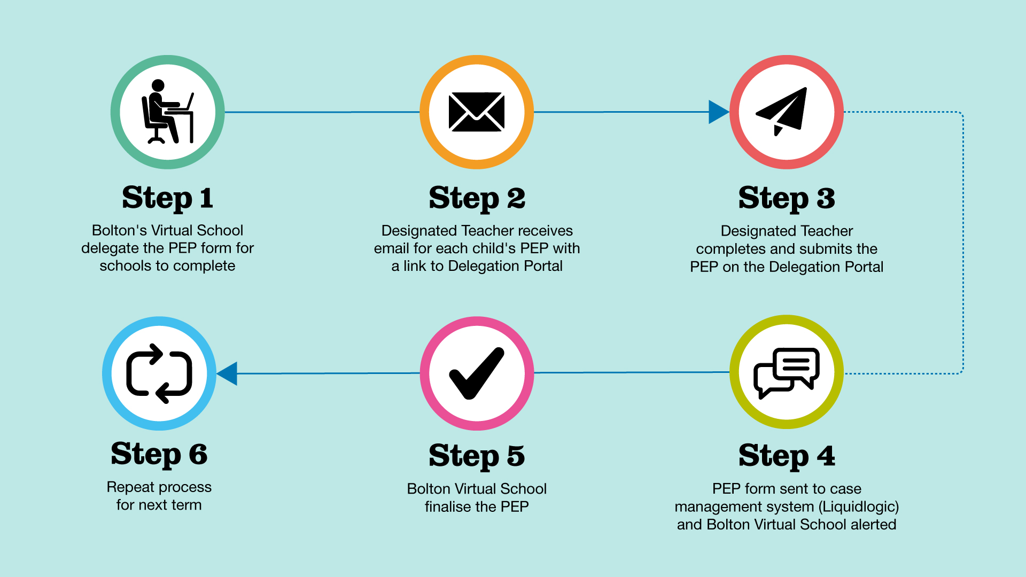
The e-PEP process

Slide 15
Walk Through (DP)

Slide 16
What do we need from you?
Full names and email addresses of all staff who will have the ePEP delegated to them
Some schools, especially secondary in the pilot have nominated Pastoral Year Heads to completed the delegate ePEP forms with the DT having overall oversight. Therefore some schools have 5-6 members of staff registered on the delegation portal
Contact the Virtual.School@Bolton.gov.uk to confirm
details of the DT
Members of staff names and email addresses
Which year or child they will be completing the ePEP for

Slide 17
Questions??
Possible FAQs:
How long will I have to complete my part of the e-PEP?
PEPs should be completed and submitted within 10 school days of the PEP meeting
What happens once I’ve submitted the e-PEP?
The VS will quality assure and provide feedback where required before finalising
When do PEPs need to be done by each term?
Autumn Term – Friday 17th December 2021
Spring Term – Friday 25th March 2022
Summer Term – Friday 15th July 2022
When will it be rolled out?
Monday 11th October, paper version to be used in the interim – old format not to be used.

Slide 18
Step by step guide to completing the PEP
You understand the child’s education experience and need, even if you haven’t met the child.
The targets are SMART
The Child’s voice is evident throughout
Everyone's roles are defined
The paperwork is complete
It is a working evolving document
It contains lots of individual detail
‘A PEP should be a ‘living’, evolving, comprehensive and enduring record of the child’s experience, progress and achievement (academic and otherwise), and inform any discussion about education during statutory reviews of the child’s wider care plan’

Slide 19
Mental Health - SDQ
 | Overall Score | Pro-social score | Areas of strength | Areas where additional support may be required
Autumn Term | 27 | 5 | Conduct | Hyperactivity and emotional symptoms
Spring Term | 28 | 5 | Conduct (in school) but this has deteriorated since last time. | Hyperactivity and emotional symptoms – to be addressed through a long term emotional care plan meeting and work with psychotherapist.
Summer Term | 27 | 3 | Conduct and pro-social are both strengths and are close to average. He is a very sociable and caring little boy. | Emotional symptoms and hyperactivity continue to be the main areas for concern. The psychotherapy and movement meditation sessions are helping with this but it is a very long process.
The Strengths and Difficulties Questionnaire should be completed by School in advance of each PEP meeting. A score of 16 or above suggests that the pupil may have emotional wellbeing needs which should be addressed within the Target Setting section

Slide 20
How to complete the termly SDQ
Online system (if available in your school)
PDF paper version
SDQ excel spreadsheet (see completed example)
A Strengths and Difficulties Questionnaire is also completed each year by the Carer as part of the Annual Health Assessment and it may be useful to triangulate these scores with those completed by school
 | Overall Score | Date and Comments
Carer SDQ
Further information
Does the child/young person have any difficulties in relation to self-care?

Slide 21
Preparing for my future
This section should be updated termly with all children and young people and Schools should consciously work to prevent all forms of stereotyping in the advice and guidance they provide, to ensure that young people from all backgrounds, gender and diversity groups, including those with special educational needs and disabilities, consider the widest possible range of careers. It is always useful to start thinking about future goals from an early age and to ensure varied opportunities are made available.
Skills and Aspirations | I’m good at playing kitchen/restaurant/hotel with Jaylen. I have good ‘setting up’ skills when planning parties. I’m proud of making friends in my class. Playing on my tablet and texting my friends on roadblox. My favourite subject are Art, Maths and topic. Staff are supporting these identified strengths in school. For example, Millie helped to set up a party for another pupil when it was his birthday.
What am I good at? What do I want to get better at? What subjects do i like? What makes me proud? What makes me happy inside of school? What makes me happy outside of school? What do I want my future to look like?

Slide 22
Our views
Top Tip: Ask the carer to share the views before the meeting either over the phone or by email!
My Views on School Use the section below to tell us what you think about school. There are some examples below of things you may want to talk about, but this is your chance to tell us what YOU want us to hear. Do you have a favourite subject? What have been your favourite things you have done? Is there anything you are really proud of or that you need extra support with? Are there things you want to tell us that you do inside or outside school? Have you picked optional subjects? | My Family’s Views on School (As agreed with the allocated Social Worker, the Designated Teacher should support Parents and Carers to complete this section in advance of the PEP meeting. Please tell us if you have any concerns about school or if there has been anything this term that has made you proud)
Autumn Term My favourite subject is PE, I think it with Mr Yellow and Mrs Indigo is good too. I liked it when we did signing during the Harvest assembly. I’m proud of the volcano book I made because it tells you all about volcanoes, lava is hot and contains lots of different chemicals. I find Maths hard and I get extra support with my 2 times tables. | Autumn Term Millie has enjoyed attending school over the last few weeks. She has lots of exciting activities to look forward to. Millie particularly enjoys the science lessons about light and video. She really enjoyed the boxing opportunity, and was disappointed when this finished. Millie speaks of his teachers very kindly and says how much she loves going to school.

Slide 23
SMART and outcome focused targets
Specific
Achievable
Realistic
Measurable
Time Limited
Linked to the child’s specific needs
Include as much detail as possible
Make sure you can measure if it is making a difference
Can you prove impact?
We need to be ambitious but targets should be within reach.
Too far will mean failure
Can they make the targets with the resources available?
Have they made any progress in this area so far?
We cannot measure success if we don’t know when to stop
Set a target to be assessed that can be extended rather than ending in failure
Top tip: Use the PEP
Handbook to help
set SMART targets!

Slide 24
Example target
SMART Outcome (Benefit or difference to an individual as a result of an intervention) | What we will do (Actions/Strategies Required) | Who will do it and when | Specific cost implications of this resource | Progress to date (Review | Has this outcome been met? | Evidence that outcome is met
Millie will have increased self-esteem demonstrated through improved SDQ scores for emotional symptoms (< or =5) and hyperactivity (< or =9) by the end of the academic year. | Weekly psychotherapy sessions to support Millie with previous trauma. | 30 mins per week with Play Therapist | £58 x 12 = £696 | Continue with target – No improvement in Emotional symptoms, with it deteriorating at home. A referral has been made to CAMHS – Jo Meadows to liaise with Julie Drinkwater however this is on hold until schools return. | Yes/No/Partial | Carry forward to Autumn Term – we know that Millie is currently struggling with her social and emotional well-being due to lockdown. As soon as schools return Millie will be prioritised and sessions will start again

Slide 25
Pupil Premium funding
It is a DfE requirement and an OFSTED expectation that schools evidence how the pupil premium is spent and how it benefits looked after children. Schools must ensure that every PEP includes SMART targets, any exceptional funding allocated and clear evidence of impact on children’s achievement of all pupil premium funding.
Pupil premium spend must be clearly linked to SMART targets, any unspent PPG+ must be returned to the Virtual School.
In all cases we reserve the right to recoup the funding if it is not being used to address the specific needs of the looked after child, as identified in the PEP

Slide 26
Pupil Premium funding (cont.)
Total amount sent to school – £1,795
Two payments
Sept to March = £1,045 . . . usually done around December
April to August = £750 . . . schools should see these amounts in July

Slide 27
Pupil Premium plus (PPG+) for looked-after children
The PP+ can be used to facilitate a wide range of educational support for looked-after children. VSH should seek the input of the school’s designated teacher and carers when deciding on how to use PP+ to support a child. It is important that interventions supported by pupil premium should be evidence-based and in the best interests of the child.
PPG+ can not be spent on: transport, administration tasks, clothing or food.

Slide 28
Appropriate use of PPG+
1 : 1 Tuition in School
Small Group Tuition
Mentoring
Tutoring at home
Behaviour Management
Training
Laptops, devices & equipment
Trips
Out of school activities
Additional support

Slide 29
Questions?

