Slide 1
Bolton Council Youth Offending Team
Date: Insert date that presentation will take place

Slide 2
Covid-19
All children deemed high risk particularly those on intensive supervision and surveillance orders, continued to have face to face contact in line with their statutory Court order
Saw young people without compromising safety of staff or service users
The office has been staffed daily with a minimal number of staff on a rota basis
GM are currently dealing with Bolton court cases - unless a child is at risk of remand or needs to be collected from Court due to vulnerabilities
Reparation packs for young people have been developed and sent out to their home
Additional support provided to staff during Covid-19
Notes:
Added specific slides in around Covid-19 with how the services provided, best practices, threats, challenges etc…
Thought this would be more appropriate to provide this overview at the start of the presentation to provide context.

Slide 3
Covid-19
Employment and education gap
Financial challenges
Impact on current service improvement priorities
Courts capacity

Slide 4
What does HMIP need to know to understand the local context for this YOT?
Bolton Local Context
Key Facts about Bolton
The borough of Bolton is a diverse area, combining both urban and rural districts. The borough contains some of Greater Manchester’s most affluent communities, and some of its most challenged.
Latest population estimates are that there are 71,115 children and young people aged 18 and under in Bolton.
Bolton is ranked 71st most deprived of 326 local authorities in England on the measure of income deprivation affecting children.
20.1% of children are in low income families as identified by HMRC (England Average is 17.0%)
Notes:
This is Bolton’s Local Context – common statistics that we would provide in Ofsted inspections or Self-View etc…
Need to review prior to presenting to ensure these are the latest figures.

Slide 5
Key Facts about Bolton
17.4% of Primary Pupils are eligible for and claiming Free School Meals (FSM) – (England 15.7%)
18.2% of Secondary Pupils are eligible for and claiming FSM – (England 14.1%)
30% of Primary Pupils in Bolton speak English as an Additional Language (EAL) (England 21%)
23.5% of Secondary Pupils in Bolton EAL – (England 16.5%)
42.5% of Primary Pupils are from an Ethnic Minority – (England 34.5%)
36.8% of Secondary Pupils are from an Ethnic Minority – (England 33%)
33.8% of Special School Pupils are from an Ethnic Minority – (England 31%)

Slide 6
Key Facts about Bolton
Policing
Highest demand across GM
More serious sexual offending, rape, domestic abuse and robbery than any other District outside of the City of Manchester (effectively 3 districts in one, North, Central and South)
Some of the highest threat Organised Crime Groups in GM over the last couple of years
Bolton always features as a high threat District for People Trafficking and Modern Day Slavery
Notes:
Specific slides on key facts about policing / youth offences in Bolton. These points included by Rick.
Rick has also noted that; The main think I'd like to get across here, is that a Child growing up in Bolton is exposed to an environment with has a disproportionate level of threat, harm and risk when compared to other Boroughs in GM. It probably isn't the place to get into resource Vs demand in this section, but we do need to get this point out at some point in the inspection - the level of demand to each key worker in Bolton is not comparable to that of other key workers across GM.
Where can we cover these points?

Slide 7
Bolton YOT performance overview
Recent YJB Stat Release
Indicator | Bolton | YOT Family | Direction of Travel From previous year
FTE rate per 10,000 (Oct-18 to Sep-19) | 185 | 240 | -22.4%
Use of custody rate per 1,000 (Jul-19 to Jun-20) | 0.24 | 0.26 | -0.11
Rates of Re-Offending - Binary (Apr-17 - Mar-18) | 39.4% | 30.7% | 5.18%
Rates of Re-Offending – Frequency (Apr-17 - Mar-18) | 2.38 | 3.54 | -49.2%
Children sentenced to custody (Jul-19 to Jun-20) | 7 | 79 (8 average) | -30% (3 cases)

Slide 8
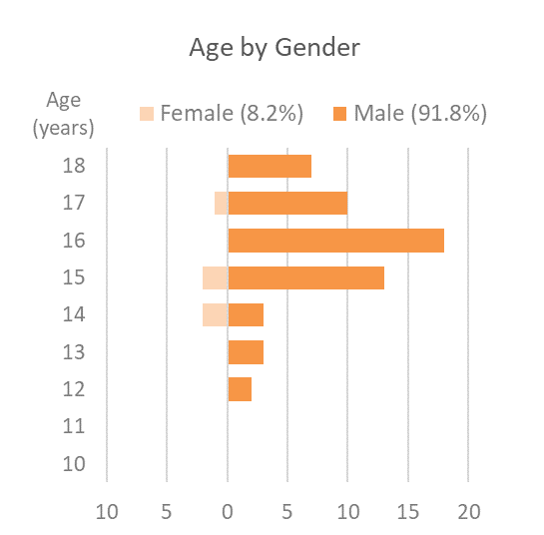
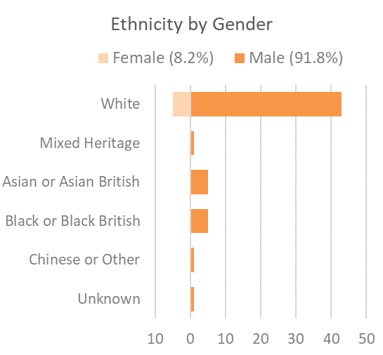
Youth Offending Profile
Presented as an example taken from cases as at July

Slide 9
Bolton Vision
The Bolton Vision Partnership has developed this vision for Bolton;
“Bolton will be a vibrant place, built on strong cohesive communities, successful businesses, and healthy residents. It will be a welcoming place where people choose to study, work and put down roots”
The ‘Guiding Principles’ which underpin the Council’s work with its partners across the borough are;
Inclusive growth and prosperity
Protecting the most vulnerable
Reforming our services in partnership

Slide 10
Bolton YOT Vision
The YOT Management Board and the YOT service have developed the YOT Vision;
“To prevent children and young people from offending, engage victims, protect the community, encourage positive life choices and maximise potential for children and young people”
The vision is underpinned by 6 strategic priorities which are supported by operational priorities, which are reviewed on an annual basis.

Slide 11
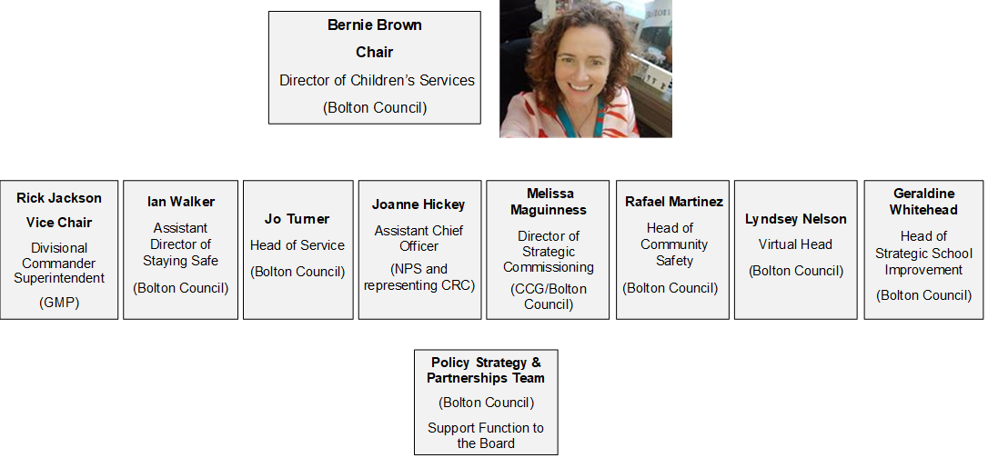
How does the governance and leadership of the YOT support and promote the delivery of a high-quality, personalised and responsive service for all children?
Governance and Leadership
Bolton YOT Management Board
Notes:
There may be some changes that we need to make on this structure.

Slide 12
Bolton YOT Management Board
The Youth Offending Management Board;
Hold the service and partners to account
Have regular oversight of performance
Work with other partners and organisations to provide key strategic links
Quality assure their own service
Board members spend time with the YOT
Attendance at away day with staff
Involved in audit against national standards
Clear terms of reference set

Slide 13
Bolton YOT Management Board
It is part of the terms of reference and responsibilities of the board members to shadow and spend time with the YOT.
Include areas of best practice noted whilst shadowing (Need feedback from board members)
GMP
The commitment of team members to improve the lives of young people
New appointments to the Team and a renewed level of energy.
Good staff engagement and consultation with regards development (away day)
The development of the Boxing group to engage and develop young people who would otherwise engage in criminality (albeit this is current on hold due to Covid)
The effectiveness of the Out of Court Disposal panel in diverting young people from the Criminal Justice System
Notes:
Feedback received from GMP. Need to ensure we capture any other areas from board members shadowing etc…

Slide 14
Partnerships
Bolton Youth Offending Team and Management Board works effectively with partners
Strong links to other Greater Manchester YOT’s
Based within Children’s Social Care
Links with multi-agency safeguarding children partnership
Work with NPS / CRC – specific recent work on transitions
Part of the Helping Earlier project group, Neglect sub-group, Child Exploitation and Missing Operational group
Head of Service sits on and is an active member of the following;
CYP emotional health and wellbeing board
Violence reduction Pilot
Children’s performance board
MHCLG Homelessness group
GM exploitation operational group
Community Safety Partnership Board

Slide 15
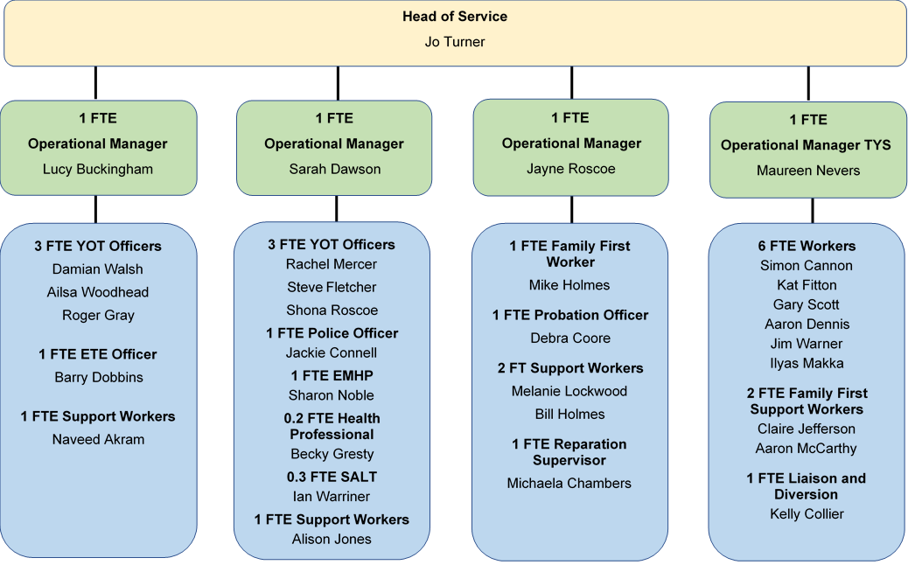
How are staff within the YOT empowered to deliver a high-quality, personalised and responsive service for all children?
Bolton Youth Offending Team
YOT Structure

Slide 16
About the team
The YOT’s main base is located in Bolton town centre – making the service as accessible as possible.
The team is made up of experienced officers and managers, who are managed by the Head of Service with oversight and governance by the Management Board.
Regular supervision takes place and the team have been provided additional support during Covid-19 (including; daily meetings and the offer of one-to-one sessions with Emotional Health Practitioner).

Slide 17
Specialist Services
Bolton Youth Offending Team offer specialist services through;
Police Officer
Emotional Mental Health Practitioner
Health Professional
Speech and Language Therapist
Education, Training, Employment Officer
Remedi
Family First Officer
Targeted Youth Support team who works alongside the YOT

Slide 18
Areas of Best Practice
Trauma clinical psychologist project
Early Help Youth Support Worker
Feedback needed from board members
A clear and stretching Vision, with an engaged and cohesive partnership / community commitment
Links between YOT and a well-resourced multi-agency Complex Safeguarding Team
Practice during COVID to retain face to face contacts for high risk and vulnerable young
Education worker is linked to 11-25 manager and the connexions team to support Children who may be NEET
Notes:
Received feedback from Rick, Rafael and Bernie Brown – need to ensure that other feedback is included.

Slide 19
Areas of Best Practice
Use of VCSE community safety funding to develop projects that support prevention and intervention
Clinical supervision and ACE/Trauma responsive approach to improve engagement with young people in the YOT
Directed and influenced serious violence community-led pilot to an area where young people are in receipt of YOT interventions. Aim to address broader locality issues and prevent others from involvement in criminality.
Operational link into the Early Intervention Youth Crime project (Steer programme) as an addition to TYS/YOT direct work

Slide 20
Is timely and relevant information available, with appropriate facilities in place, to support a high-quality, personalised and responsive approach for all children?
Management Information
Data dashboard is available to YOT Managers providing information. Dashboard is being developed to ensure timely and relevant information is available.
Regular management team meetings are held, issues / learning is discussed.
Supervision with staff to provide any feedback.
Quarterly performance reports are produced and presented to the management board.
Information is escalated, significant incidents are raised via Senior Manager Alerts.
Head of Service develops a quarterly report which is presented to the Board.
Intelligence from partnership work is communicated.
Actions raised from the above ensures a high-quality, personalised and responsive approach for all children.

Slide 21
How have you responded to findings and recommendations from previous inspections, including thematic inspections?
Learning and improvement
Along with the review of management information, the YOT take the findings from previous inspections to ensure a high-quality service is in place. The following have recently taken place;
GM Peer Reviews
Internal audits
Commissioned external audits – audit recently took place with positive feedback
Self-assessments – recent self-assessment against national standards
Review of published inspection reports that take place in other Youth Offending Services – learning / outcomes have been presented to the board
Any findings / outcomes then formulate an action plan which forms part of the overall service improvement plan.

Slide 22
What are your current challenges?
Challenges
Serious youth violence
Breaches
Sexual offences
Covid-19 short and long-term effects
- Hidden harm
- Face to face engagement
- Staff working arrangements
Notes:
Just a bit of background to the team’s role – part of our role is around supporting and co-ordinating inspections for the department. We’ve had a lot of involvement in Ofsted inspections in the past we will have involvement in the YOT inspection. We monitor inspection results as they are published and analyse the key themes coming out of these. I think this is useful context to some of the discussions we will be having today.

Slide 23
What are your current challenges?
Challenges
Feedback needed from board members
The level of demand to each key worker in Bolton is not comparable to that of other key workers across GM
Financial difficulties in the next 12 months due to recent events – which will lead to higher rates of deprivation, unemployment and mental health issues
Notes:
Points from Rick Jackson

Slide 24
What are your priorities for further improvement?
Priorities
Bolton YOT Strategic and Operational Priorities
Strategic and operational priorities and an improvement plan are developed on annual basis and monitored regularly. These support the YOT Vision.
These are determined by considering the following;
Self-assessment
Performance data and analysis (including disproportionality)
Outcomes from QA and Audits
Learning from inspections
Learning from SCRs
Local and national intelligence
Feedback from service users and families
Input from YOT staff and YOT Management Board

Slide 25
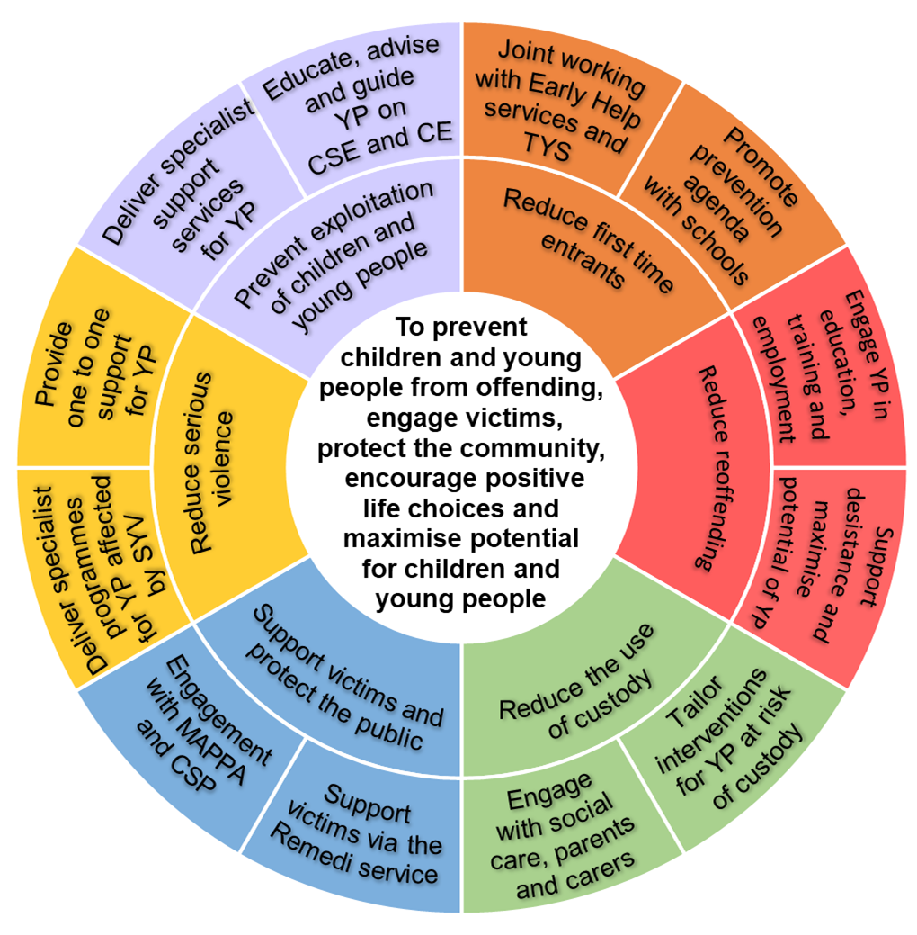
YOT Strategic Priorities
The YOT strategic priorities for 2020/2021 are;
Reduce first time entrants
Reduce reoffending
Reduce the use of custody
Support victims and protect the public
Reduce serious violence
Prevent exploitation of children and young people

Slide 26
YOT Operational Priorities
The YOT operational priorities underpin the strategic priorities.
These are included in the service improvement plan.

